Slide 1
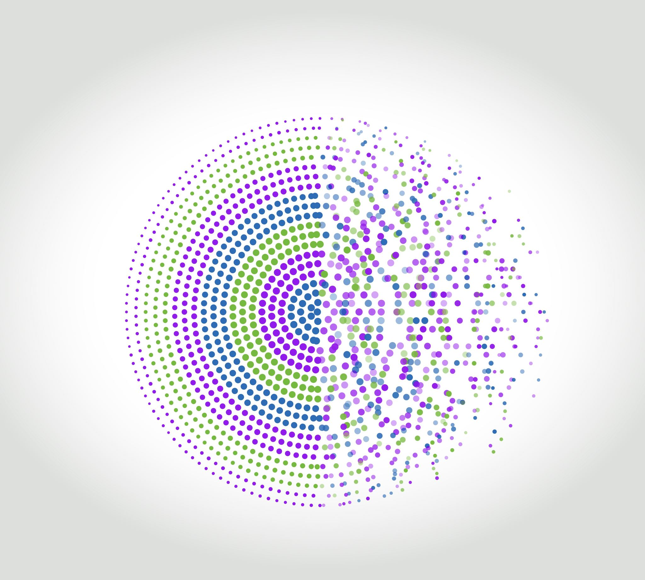
Beauty saloon
Research presentation
Guidelines and requirements
Raimonds Arājs, Jurijs Bojārs, Māris Peskops

Slide 2
1. Website Development

Slide 3
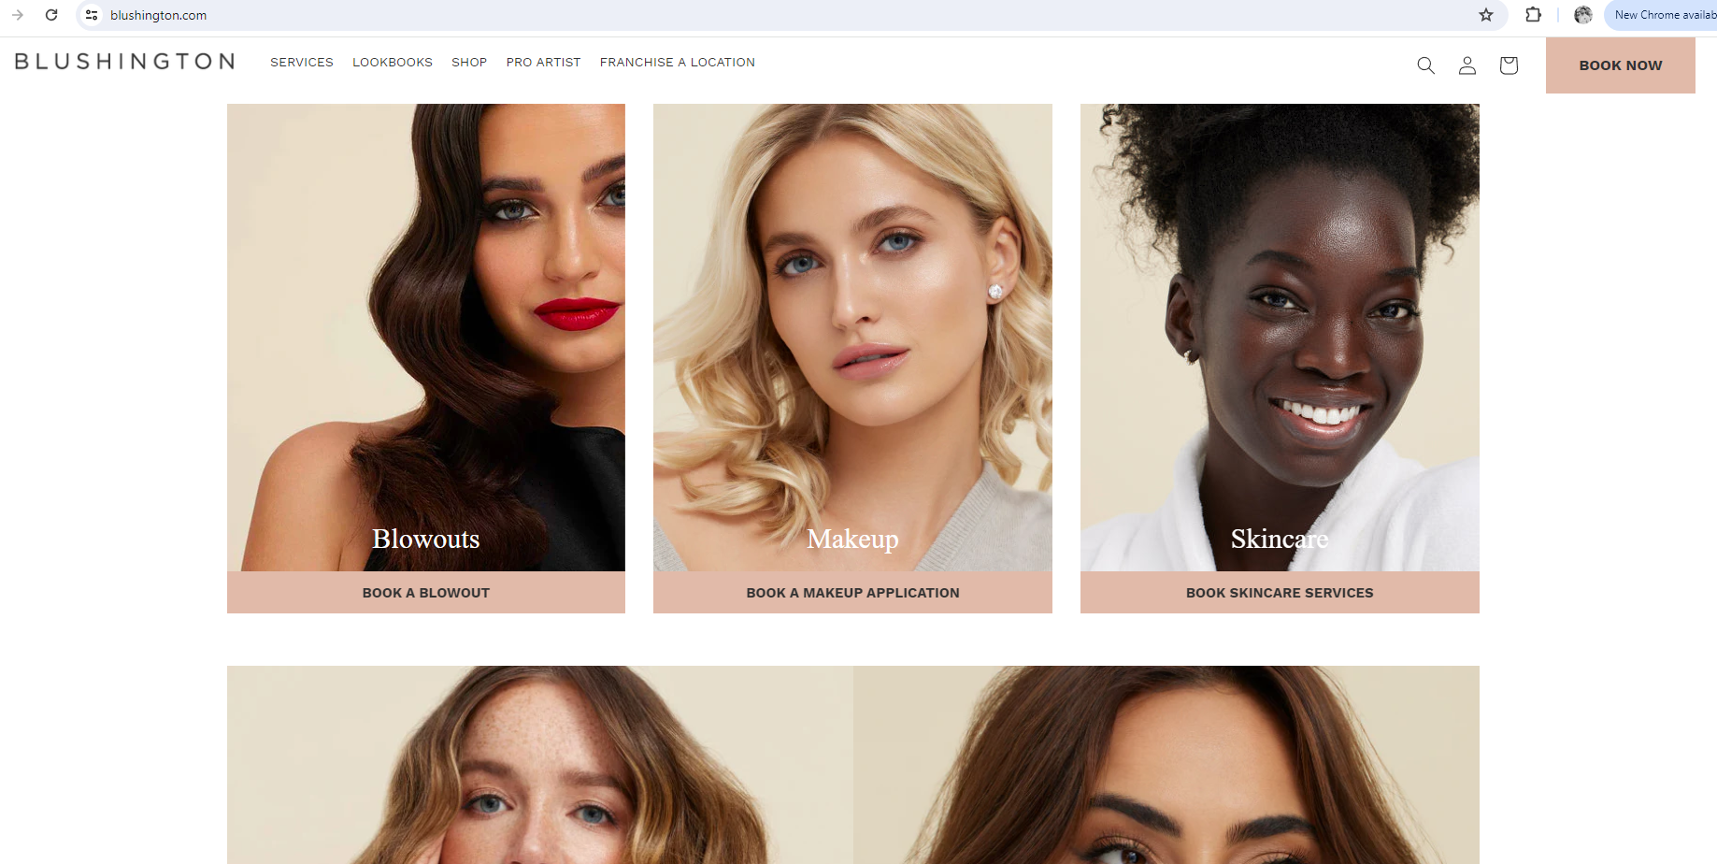
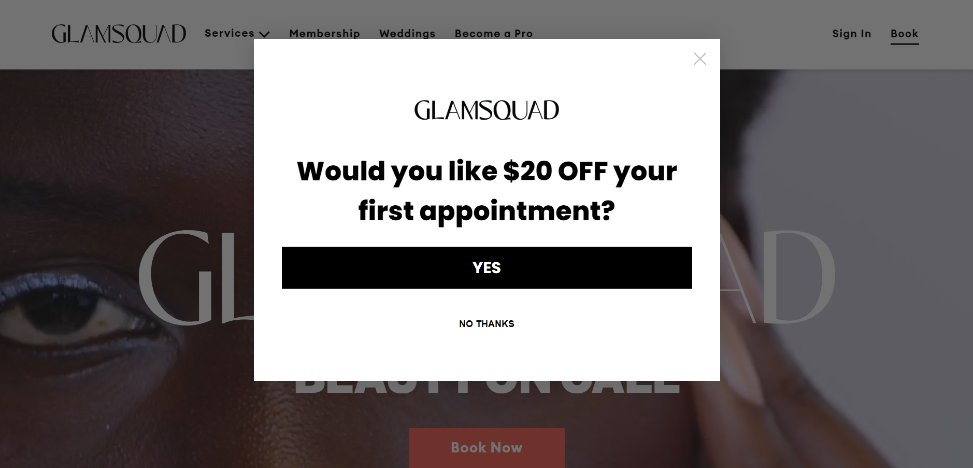
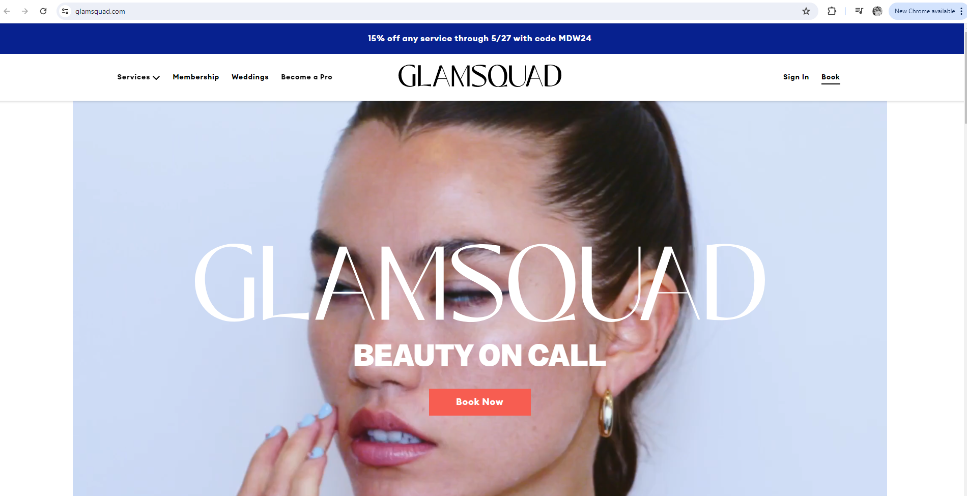
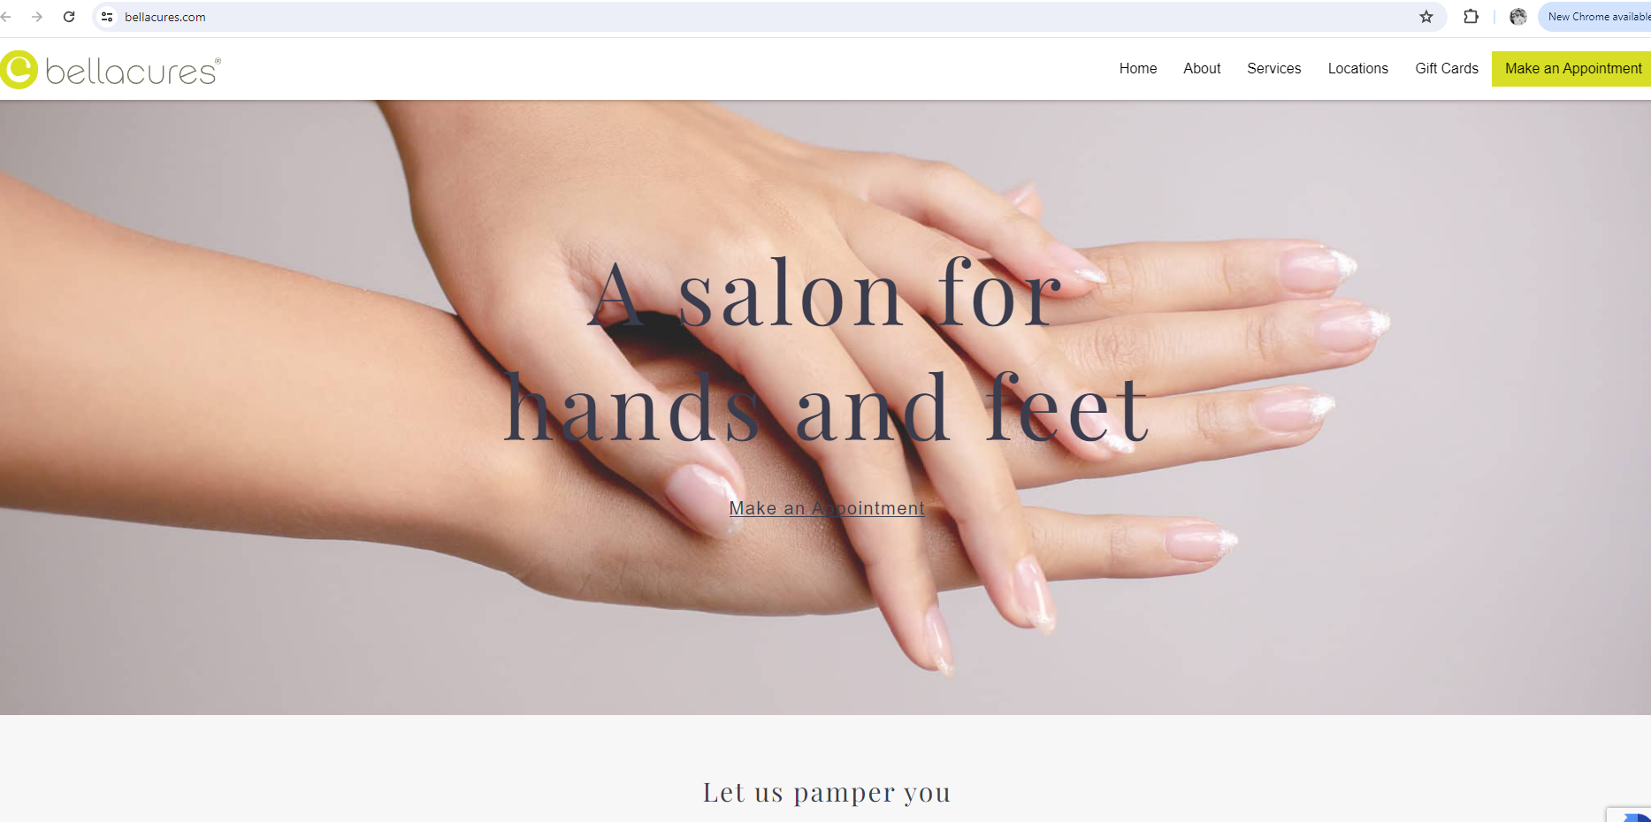
Website Development
Use simple navigation
Similar to competitors and best practices
Beauty saloon
Notes:
User-Friendly Design: Ensure the website is easy to navigate and visually appealing
Ensure the website is easy to navigate and visually appealing
Responsive Design: The site must be mobile-friendly.

Slide 4
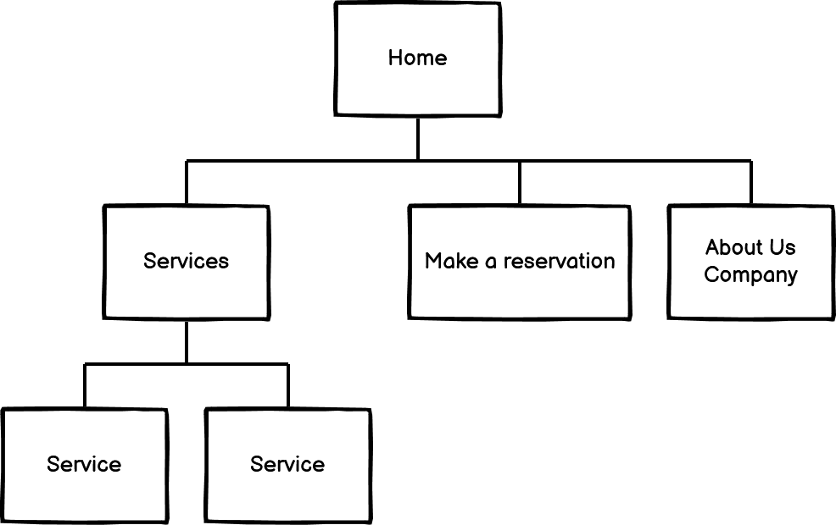
Sitemap structure
Notes:
User-Friendly Design: Ensure the website is easy to navigate and visually appealing
Ensure the website is easy to navigate and visually appealing

Slide 5
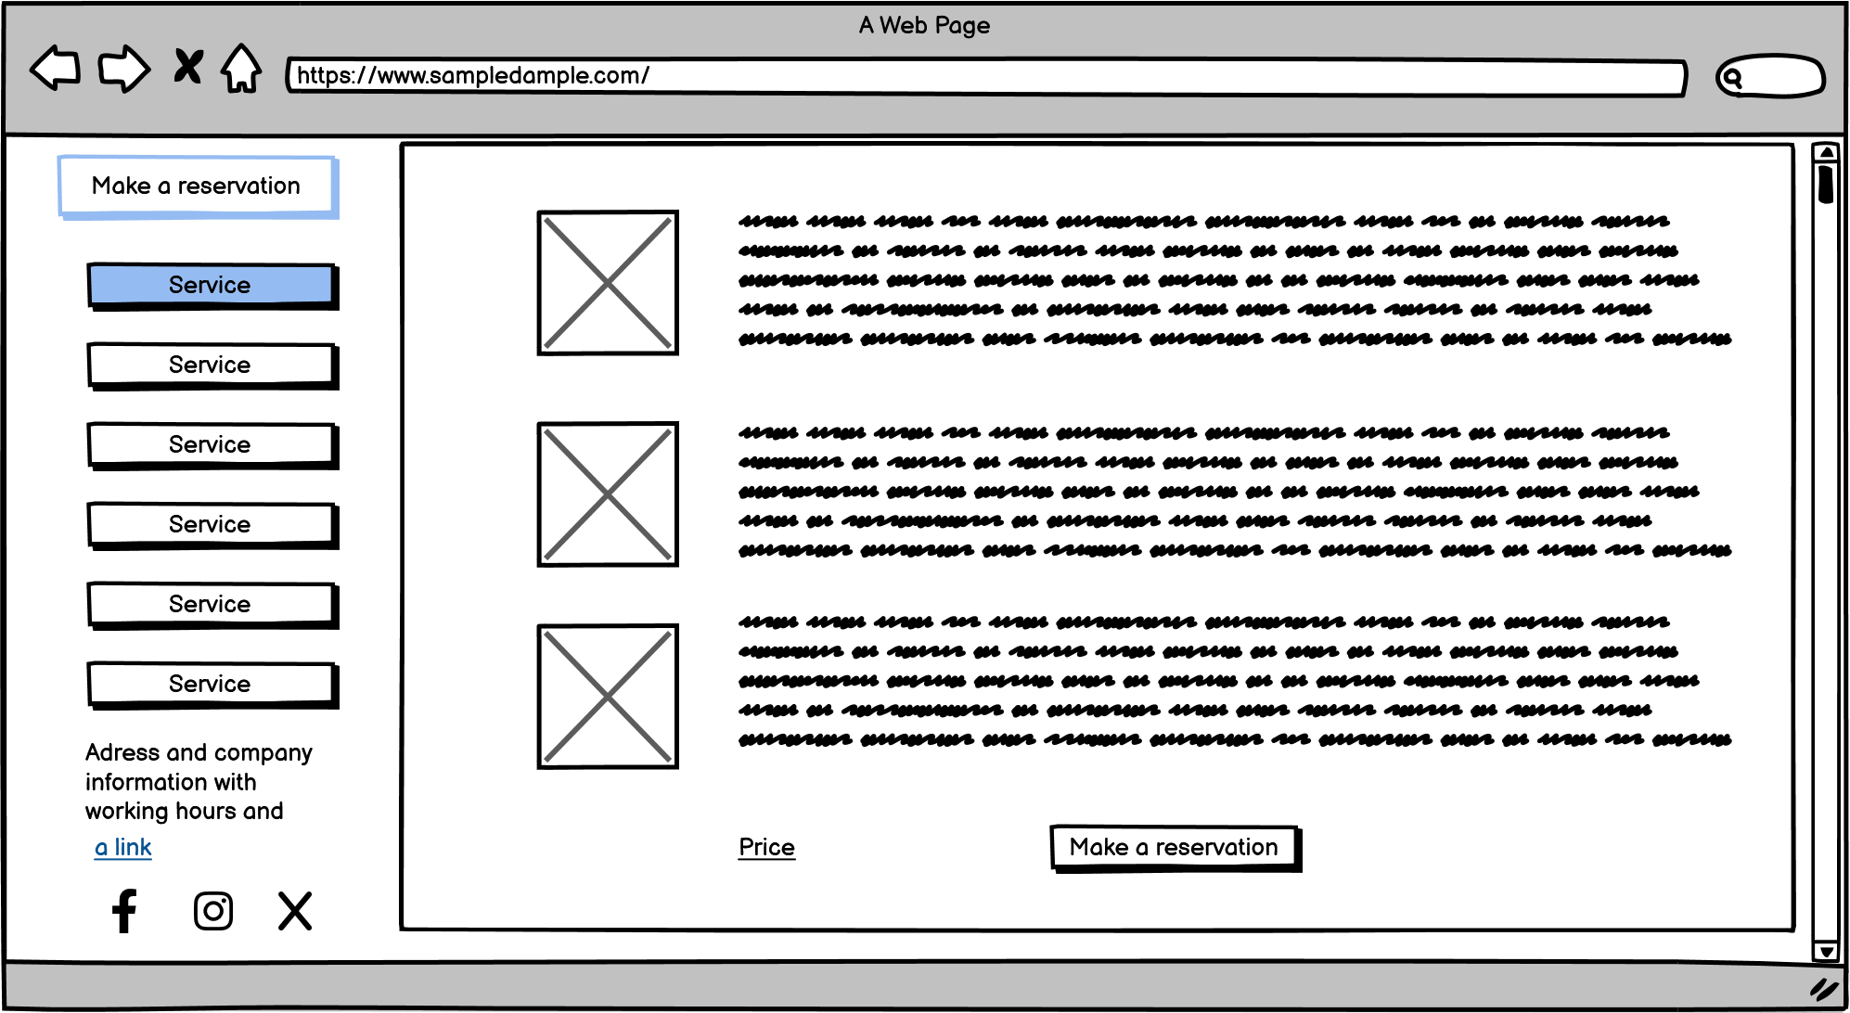
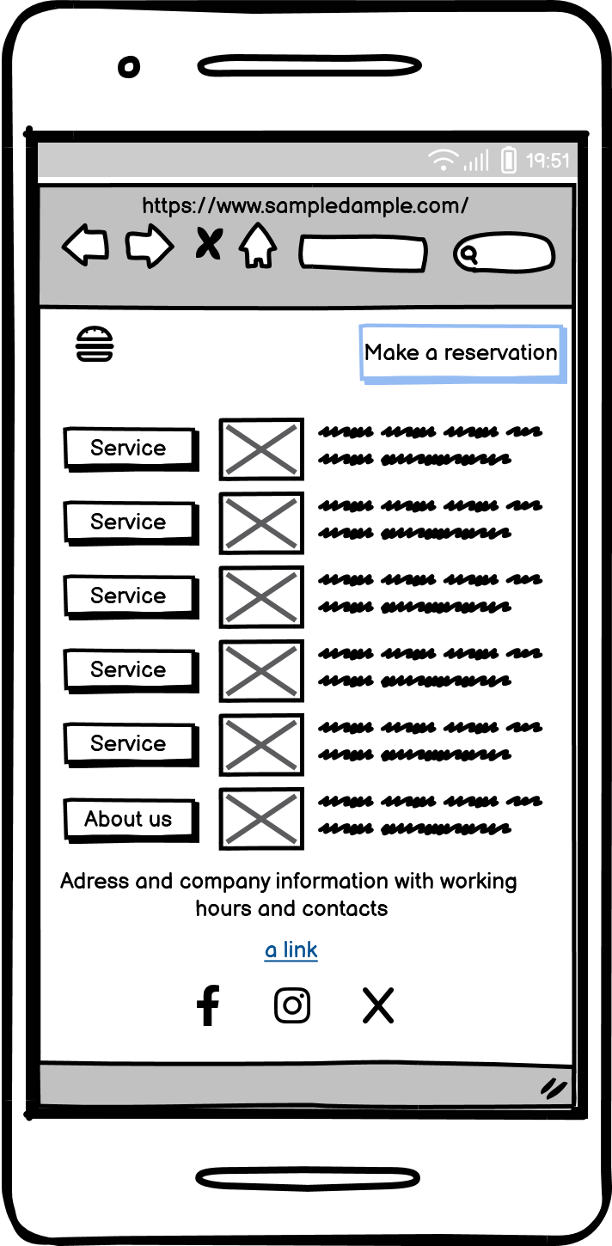
User-Friendly Design on all devices
Notes:
Pastastit ka tiks lietit H1 headingi utml priekš SEO – no prakses
User-Friendly Design: Ensure the website is easy to navigate and visually appealing
Ensure the website is easy to navigate and visually appealing

Slide 6
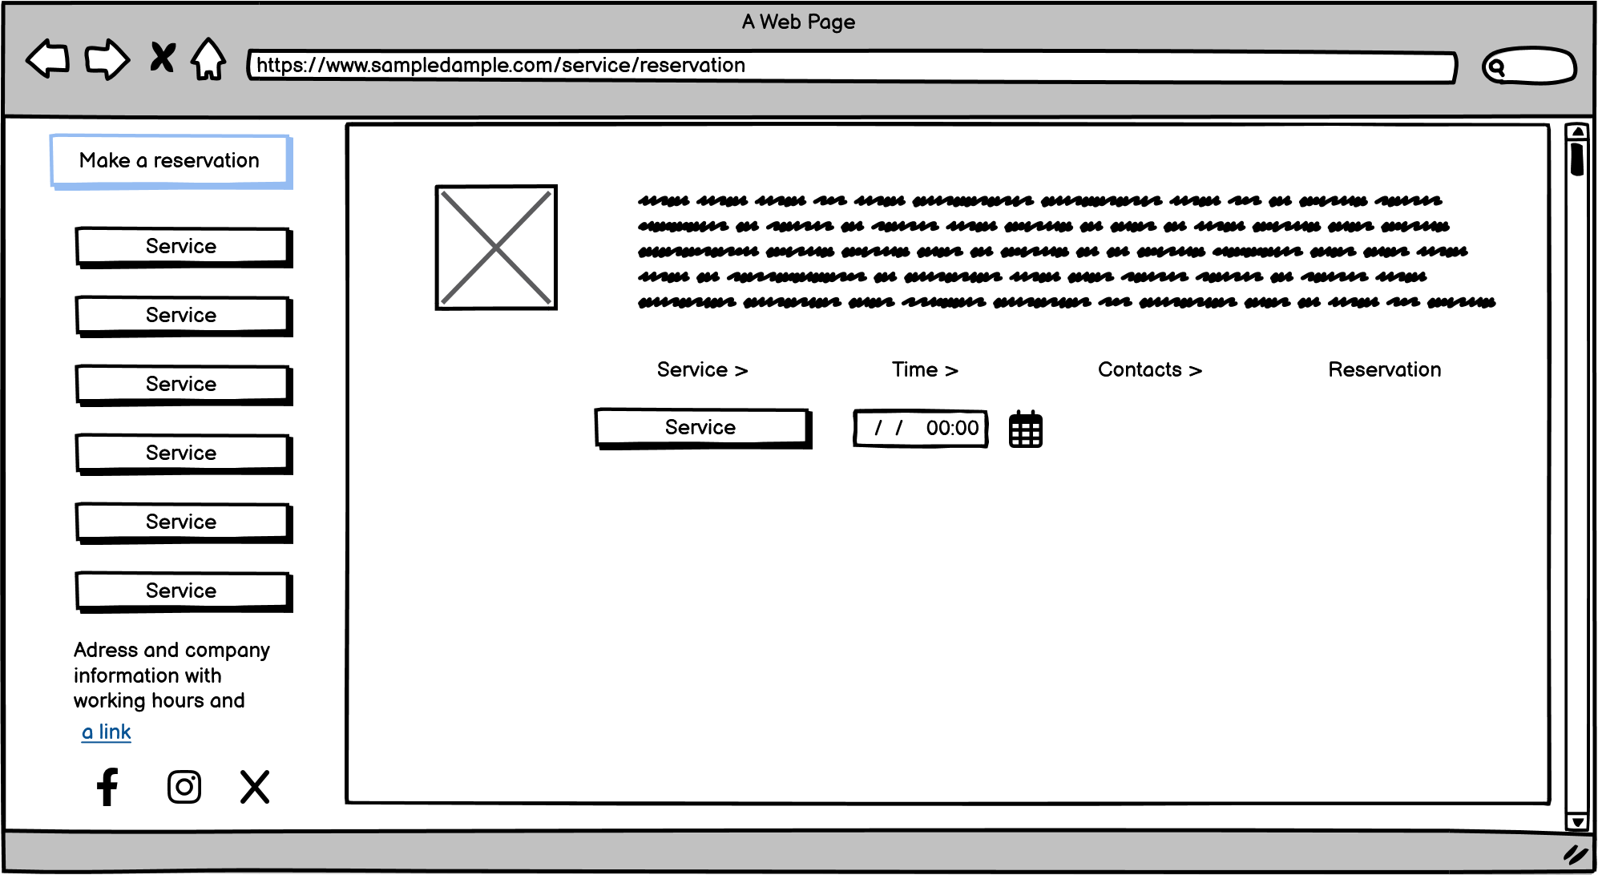
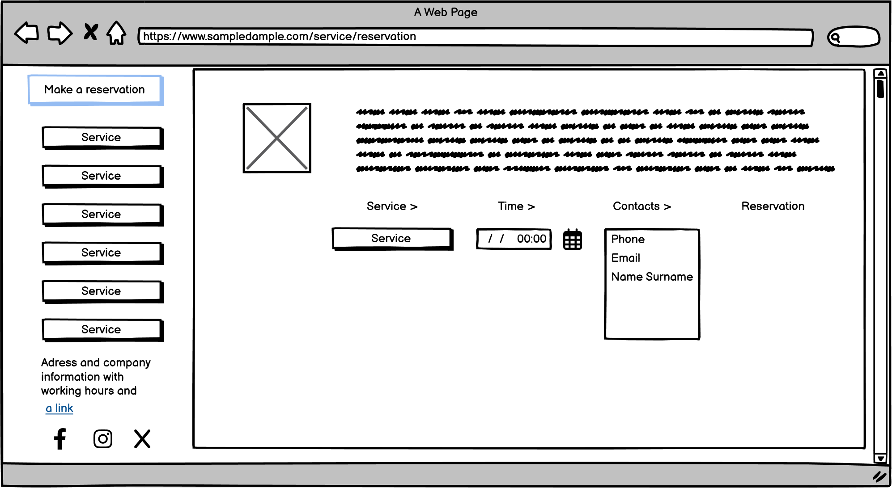
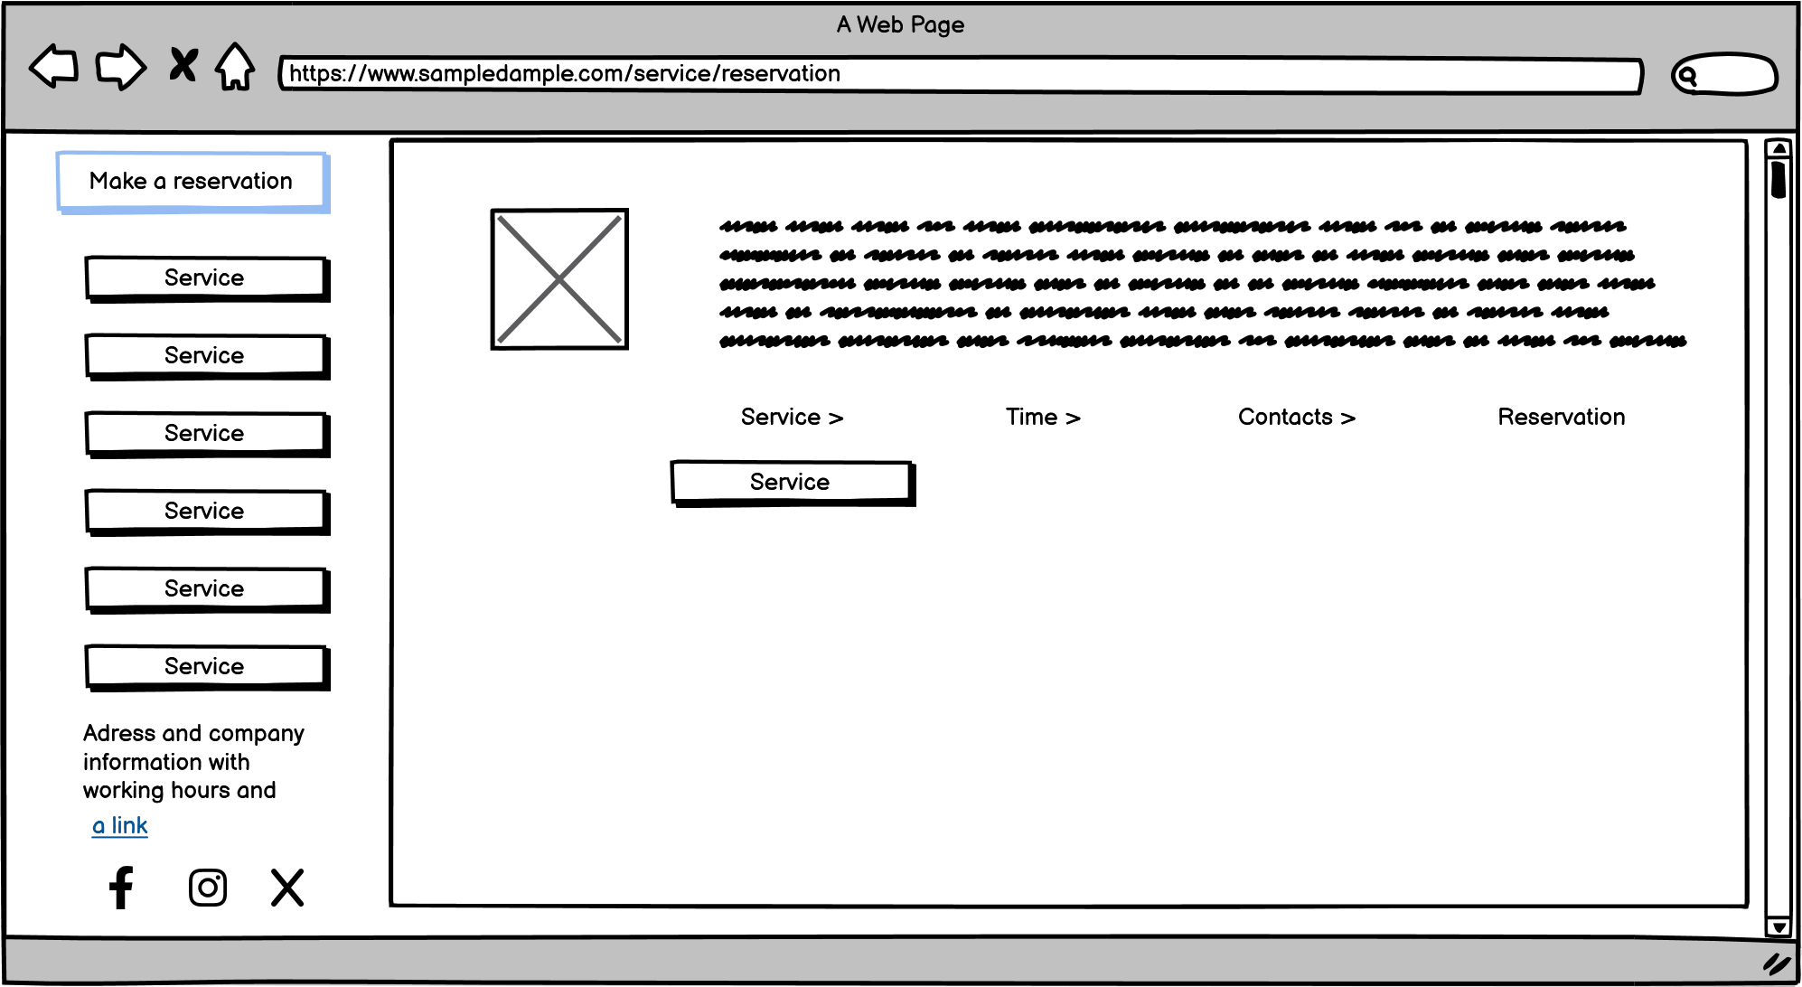
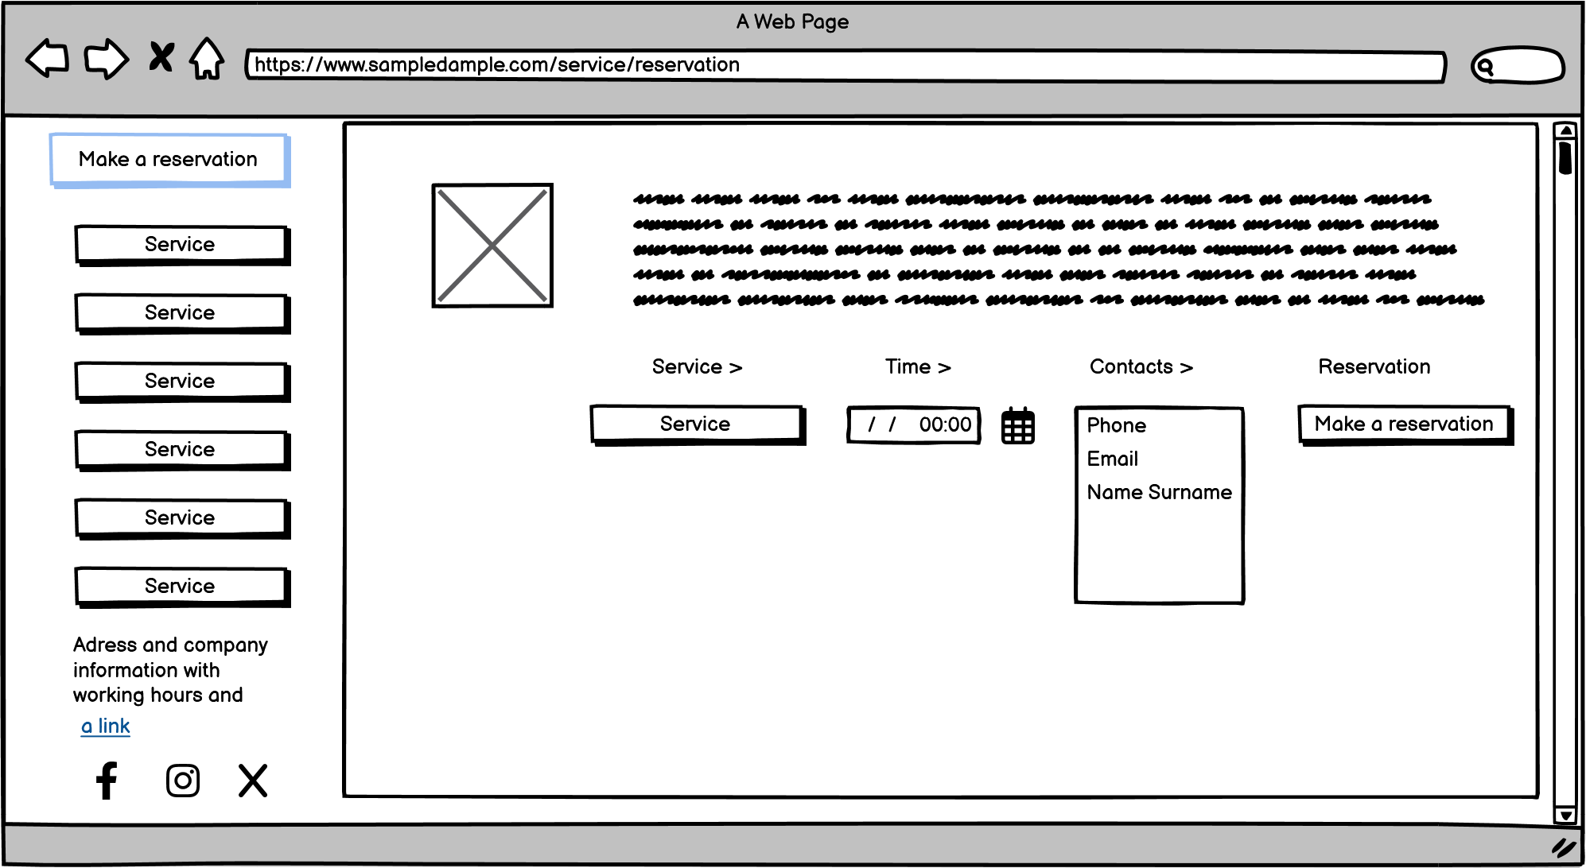
User-Friendly Design – Call To Action for booking
Notes:
User-Friendly Design: Ensure the website is easy to navigate and visually appealing
Ensure the website is easy to navigate and visually appealing

Slide 7



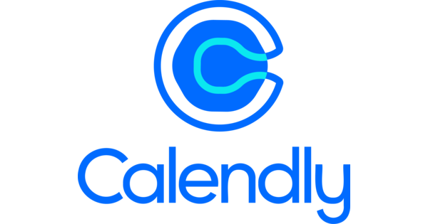
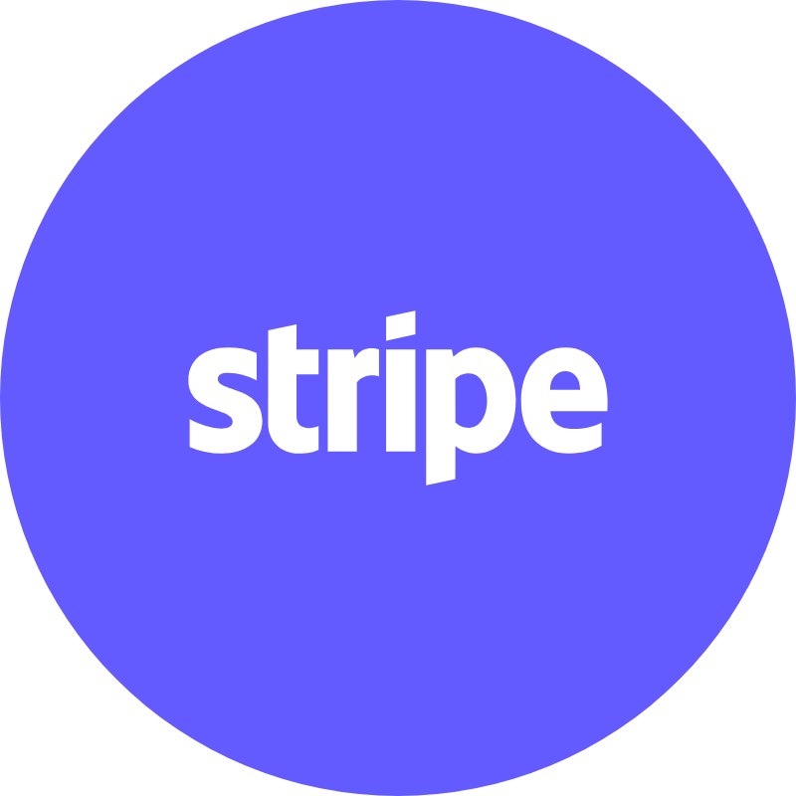


Site Development – used tools
For website – CMS Wordpress
Elementor for site building
Add SSL Certificate for the https
YOAST SEO add on for SEO management – sitemaps, eading management etc.
Calendly, Motopress or Salonbbokingsystem – so to manage bookings
Stripe integration for payments
Adding code snippets for calendar and stripe in page
Adding Hotjar for heatmap
Focus on booking system - but some in site payments may be in future
Notes:
https://www.salonbookingsystem.com/
https://motopress.com/products/appointment-booking/
https://embedcalendly.com/

Slide 8

Google – Site registration and Analytics main tasks
Register as business for Google - to find the business physical location
1
Register site for Google Search Console
2
Register/ verify for Google analytics and Ads
3
Add the Google Tags in site to track visitors
4
Also check if Facebook/ Meta Pixel also should be added – gives analytics
Analytics Integration: Implement Google Analytics to track visitor behavior and site performance
5
Collect the booking information for later use
6

Slide 9
2. Search Engine Optimization (SEO)

Slide 10
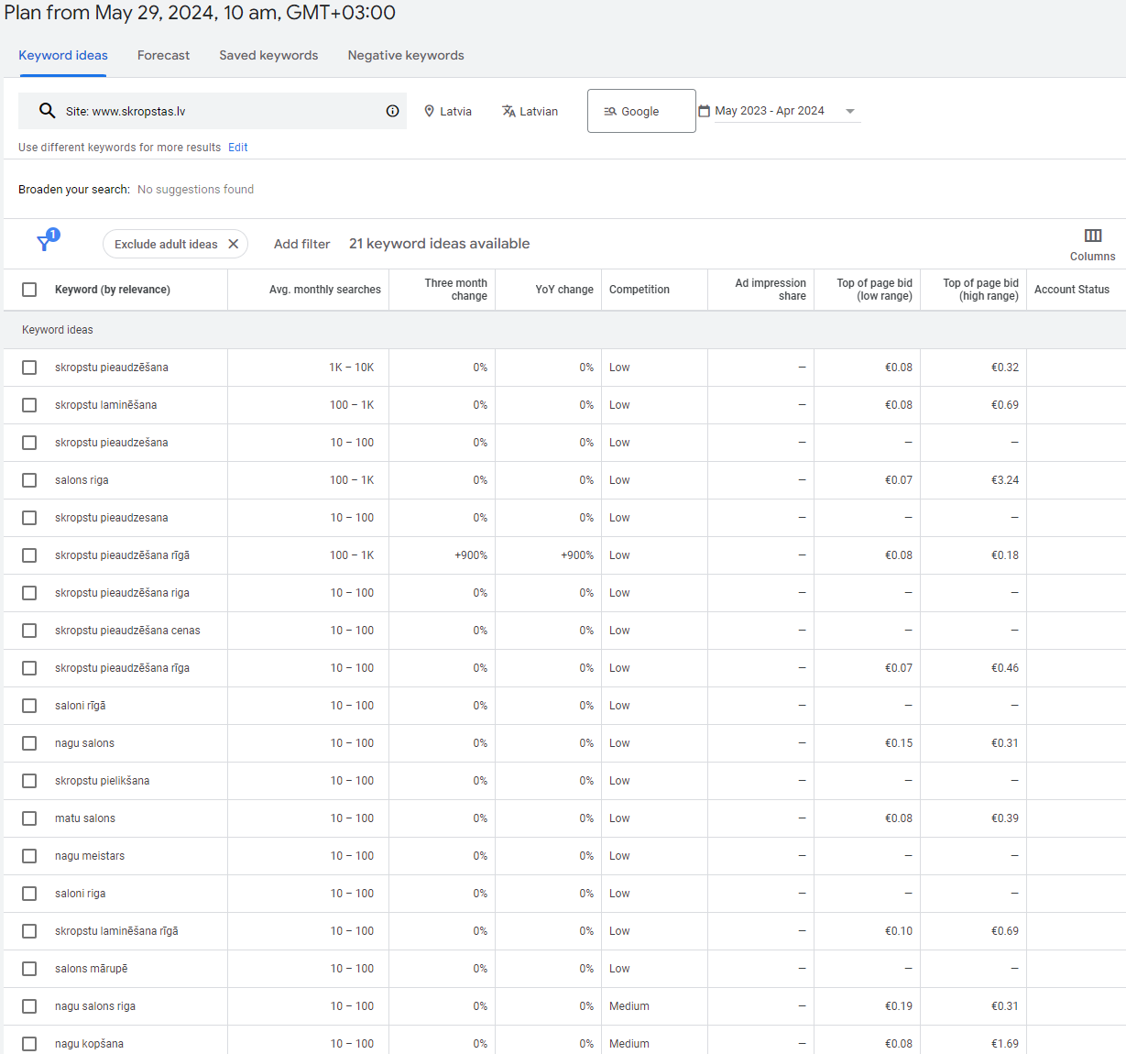
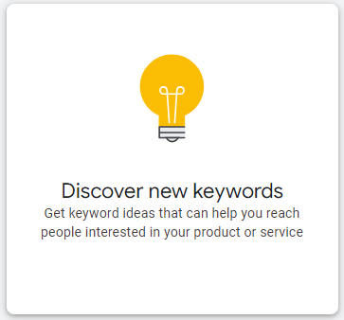
Google Keyword Planner

Slide 11
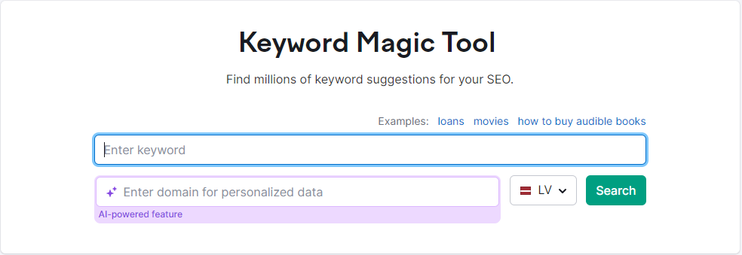
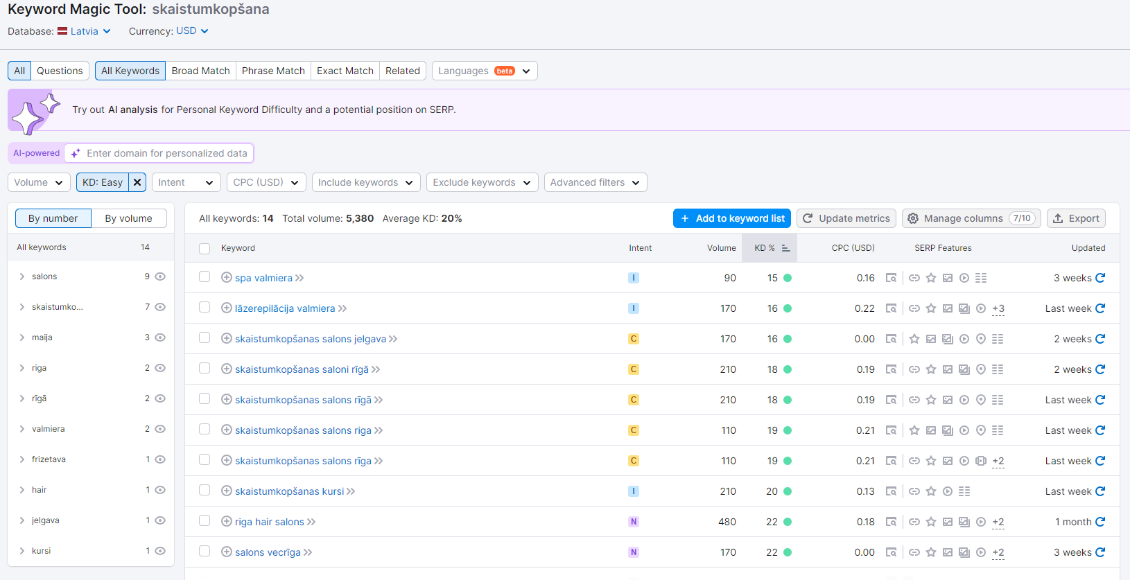
Keywords with high search volume and low competition.

Slide 12
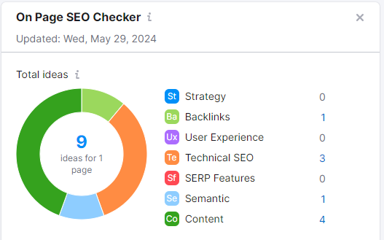
On-Page SEO
Title Tags
Include primary keywords in the title tags.
Meta Descriptions
Write compelling meta descriptions with relevant keywords.
Headings
Use H1, H2, and H3 tags effectively, including keywords.
URL Structure
Short URLs, descriptive, also use keywords.
Content
Quality, informative, and engaging content that incorporates with keywords.

Slide 13
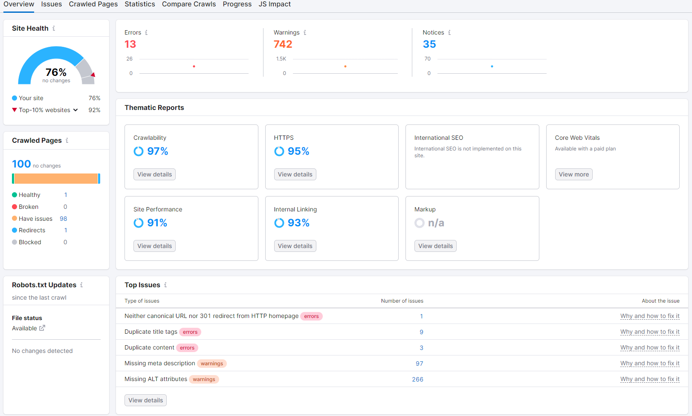
Technical SEO
Technical SEO refers to the optimization of a website’s technical aspects to improve its search engine rankings. This includes improving the website’s infrastructure to make it easier for search engines to crawl, index, and understand the content. It focuses on the backend of the site and covers aspects that enhance site performance, user experience, and search engine friendliness.

Slide 14

3. Paid Advertisements

Slide 15
3. Paid Advertisements
Budget allocation.
Google Ads - 2000 EUR
TikTok - 2000 EUR
Instagram - 1500 EUR
Youtube - 1000 EUR
Facebook - 1000 EUR
Affiliate networks - maximum budget is 10000 EUR(performance marketing, we will work on CPA basis)
Total budget: 17500 EUR

Slide 16

Ad creation(example)

Slide 17
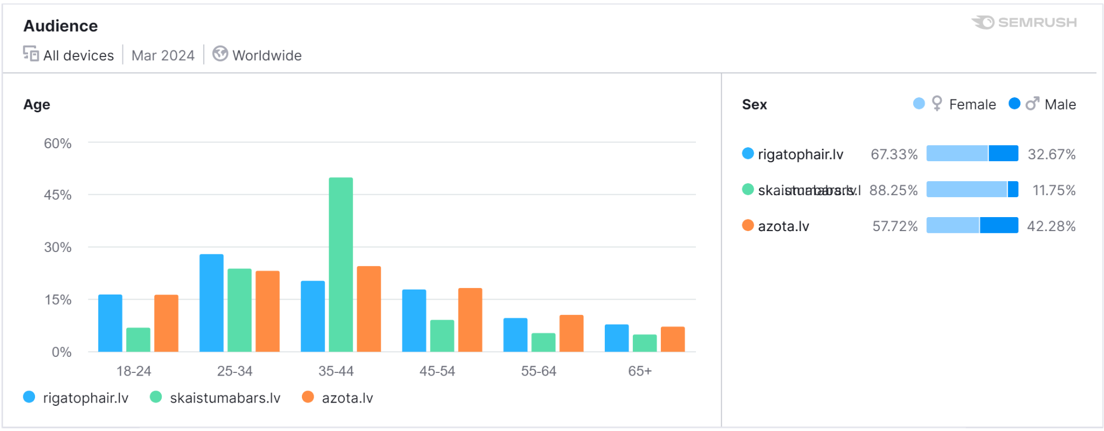
Targeting

Slide 18
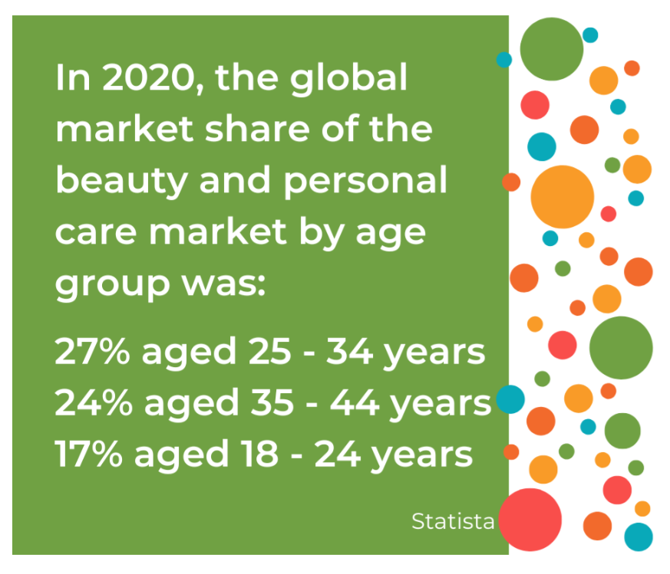
Our audience.
Woman and man, age 18 - 65+ living in any place of Latvia.
People who likes to watch Youtube video.

Slide 19
Trends
Some current trends to be aware of include eco-friendly and natural products, sustainability, and convenience. Consumers are becoming more conscious of the impact of their actions on the environment, and they are looking for products that are sustainable and eco-friendly.
Moreover, consumers are also looking for products that are convenient and easy to use. With people leading busy lives, they want products that can help them save time and effort. This has led to the rise of multi-functional products like 2-in-1 shampoos and conditioners and dry shampoos.

Slide 20
Tracking and Analytics
GoogleAds - Google analytics provides all necessary tracking and data analytics to measure advertisement campaign performance.
Instagram -
Youtube - we can use Youtube studio for analytics and performance measurement. Youtube studio also provides tracking of all necessary actions.
Facebook Ads - Meta Ads manager provides all necessary tracking and data analytics to measure advertisement campaign performance.
Affiliate campaigns. For affiliate campaigns we can use either Affise platform and create either own campaign or make integrations with any other affiliate network. Affise has all necessary statistics and analytical data what we need, it also provides tracking of all necessary actions such as clicks, impressions, downloads, installs, purchases and so on.

Slide 21
4. Social Media Marketing

Slide 22
4. Social Media Marketing
Platforms. Most relevant:
TikTok
Instagram
YouTube
Facebook
Not relevant:
LinkedIn
Other business social networks

Slide 23
A/B Testing requirements
Running our sampling campaigns across different channels can quickly give as insight into where our ideal customers are the most engaged.
Do our customers respond more to science-backed product claims, or influencer testimonials of our product?
Offer multiple products in a sample campaign is a great way to test what is resonating more with our customers.

Slide 24
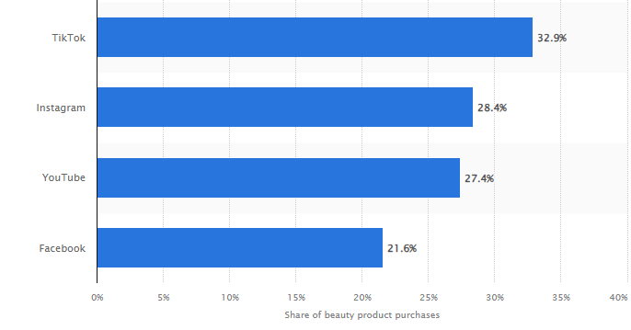
Beauty products purchases in social networks

Slide 25
Content calendar
Season | Period | Action
Spring (March - May) | Week 1-2 | Spring skincare routine tips and product recommendations.
 | Week 3-4 | Makeup trends for the spring season, including pastel colors and dewy looks.
 | Week 5 | Earth Day-themed content highlighting eco-friendly beauty products.
Summer (June - August) | Week 1-2 | Sun protection tips and summer skincare essentials.
 | Week 3-4 | Beach beauty essentials and heat-proof makeup tutorials.
 | Week 5 | Summer solstice celebration with a special promotion on sun care products.
Fall (September - November) | Week 1-2 | Transitioning skincare from summer to fall: hydrating products and gentle exfoliation.
 | Week 3-4 | Fall makeup trends featuring warm tones and bold lip colors.
 | Week 5 | Halloween makeup tutorials and product recommendations for festive looks.
Winter (December - February) | Week 1-2 | Winter skincare survival guide for cold weather, focusing on hydration and protection.
 | Week 3-4 | Holiday makeup looks and gift guides for beauty lovers.
 | Week 5 | New Year's Eve glam tutorials and product bundles for a festive season finale

Slide 26
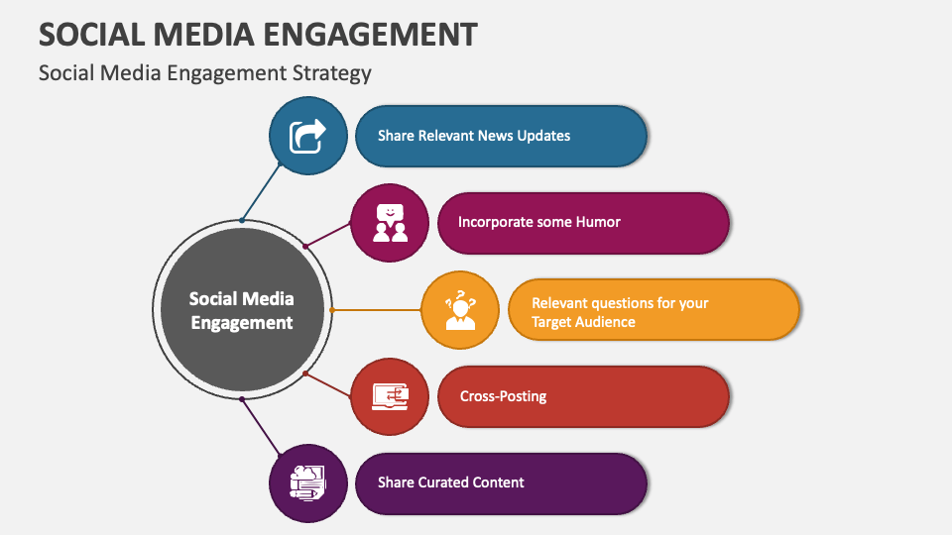
Engagement strategy

Slide 27
Influencer Partnerships
We want to make partnerships with influencers in next domains:
Beauty care
Design
Family
Food
Art and show business
Entertainment
Fashion and style
Sports and fitness
Preferable number of followers should be starting from 20K.
All influencers must have good reputation.

Slide 28
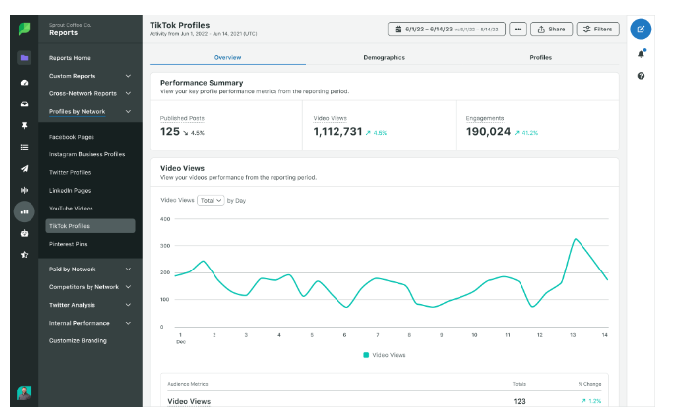
Analytics tools for TikTok. Sprout social.
Sprout Social is an all-in-one social media management platform that offers a number of features — TikTok analytics being just one. Sprout Social can be used to create a birds-eye-view of your entire social media plan.
Key features:
Build custom reports so you’re including the exact metrics and data that are important to your business.
Separate paid and organic analytics to seamlessly include in reports.
View your results in different graphs so you can easily see what the numbers mean.
Access your analytics overview, audience demographics and engagement data from your TikTok.

Slide 29
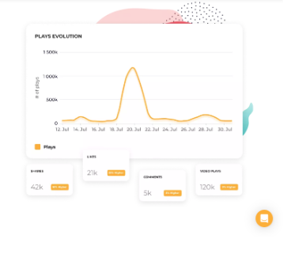
Analytics tools for TikTok. Socialinsider.
Socialinsider is another social media management tool that offers several different features—TikTok analytics being one of them. Socialinsider enables its users to monitor metrics like views, engagement, follower growth and more, while also giving them access to information like historical content trends and top-performing content.
Key features:
Compare your TikTok metrics over time by viewing historical data to find trends within your own content.
Discover your most popular categories of content so you can easily create more that resonates with your audience.
View charts and graphs with your TikTok metrics to interpret their meanings.

Slide 30
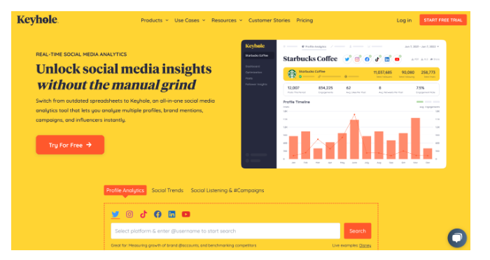
Analytics tools for TikTok. Keyhole.
Keyhole is another comprehensive tool that is solely dedicated to social media analytics and helping brands monitor their online performance. While brands can access publishing and scheduling tools, most features include social listening, historical trend tracking, influencer tracking and the like.
Key features:
Measure your accounts over time to get accurate historical data and trend analysis.
Find optimal posting times to further improve your overall reach and presence.
Get deeper insights into your audience and what they want to see from you.

Slide 31
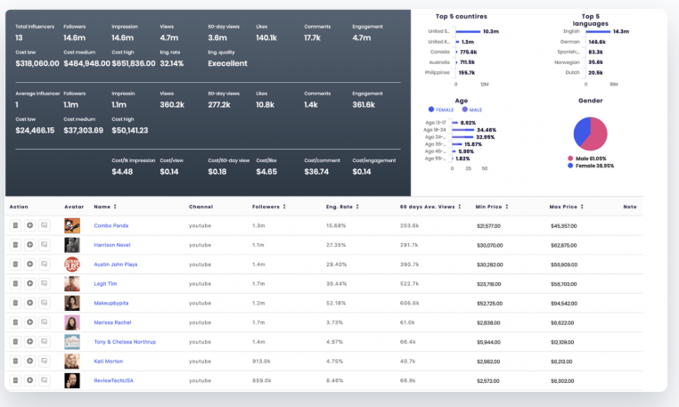
Analytics tools for Instagram. SocialBook.
SocialBook is an Instagram analytics tool that helps brands and influencers boost their social media outreach and grow their business. SocialBook helps brands save time in searching for, contacting, and collaborating with influencers.
SocialBook best features
Manage influencer relationships by adding notes to profiles and get a clear picture of collaboration
Integration features let you send bulk emails to all the influencers in your list in one go
Evaluate each influencer’s performance and revenue by tracking their unique coupon codes
Track marketing KPIs using the account analytics dashboard and get insights on campaign costs

Slide 32

Analytics tools for Facebook. Quintly.
Quintly is a social media analytics tool that allows you to see detailed analytics for all of your Facebook ads. This includes campaign information, ad performance, and audience insights.
With the help of this powerful software Facebook ads platform, you’ll be equipped with all the tools you need to track and analyse the Facebook KPIs that matter to your business. For instance, you can analyse how many new fans you gain, where they come from, their age and gender, etc. The platform also tracks what type of content resonates with your audience the most by tracking comments, shares, and likes.
Another great thing is that you’ll be able to integrate paid data into your overall marketing analyses and combine it with organic data to improve your overall strategy.
Key features:
Choose from 350+ metrics to set up meaningful analyses.
Draw valuable conclusions from competitive analysis and stay on top of what other players do.
Convert your analysis into recurring, automated reports.

Slide 33
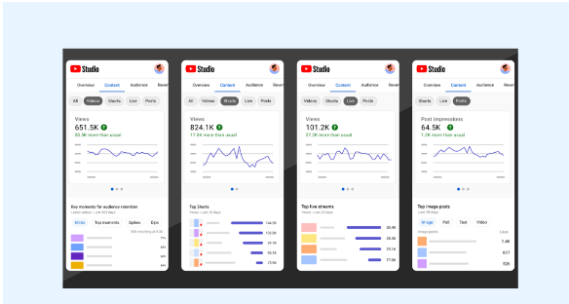
Analytics tools for TikTok. YouTube Analytics Studio.
The best place to start with YouTube analytics tools has to be the platform’s native insights studio. Available to all channels and creators, this in-built analytics platform gives you a helpful insight into your channel and content’s performance.
Use the Overview tab to grab a speedy summary of your account’s performance at a glance before diving deeper into channel-specific and video-specific metrics.
If you’re experimenting with YouTube for the first time, this is a beginner-friendly tool you should use to track your content performance and your account’s analytics.

Slide 34
5. Content Marketing

Slide 35
Content strategy
Content ideas and types
Blog Posts
Eyelash Extension Care
Tips for maintaining your eyelash extensions
Seasonal Skincare
How to transition your skincare routine from winter to summer
Beauty Trends
Latest eyelash and nail trends for 2024
Beauty Myths
Common myths about eyelash extensions
Instagram and Facebook
Before and after photos of eyelash extensions and nail treatments.
Client testimonials and video reviews.
Behind-the-scenes content showing the salon, staff, and treatment processes.
YouTube and Instagram Reels
Tutorials
Client testimonials and transformations
Interviews with the beauty experts
User-Generated Content
Clients shared experience on social media using hashtags
Contests or giveaways

Slide 36
6. Email Marketing
Notes:
https://mailchimp.com/integrations/wordpress/

Slide 37
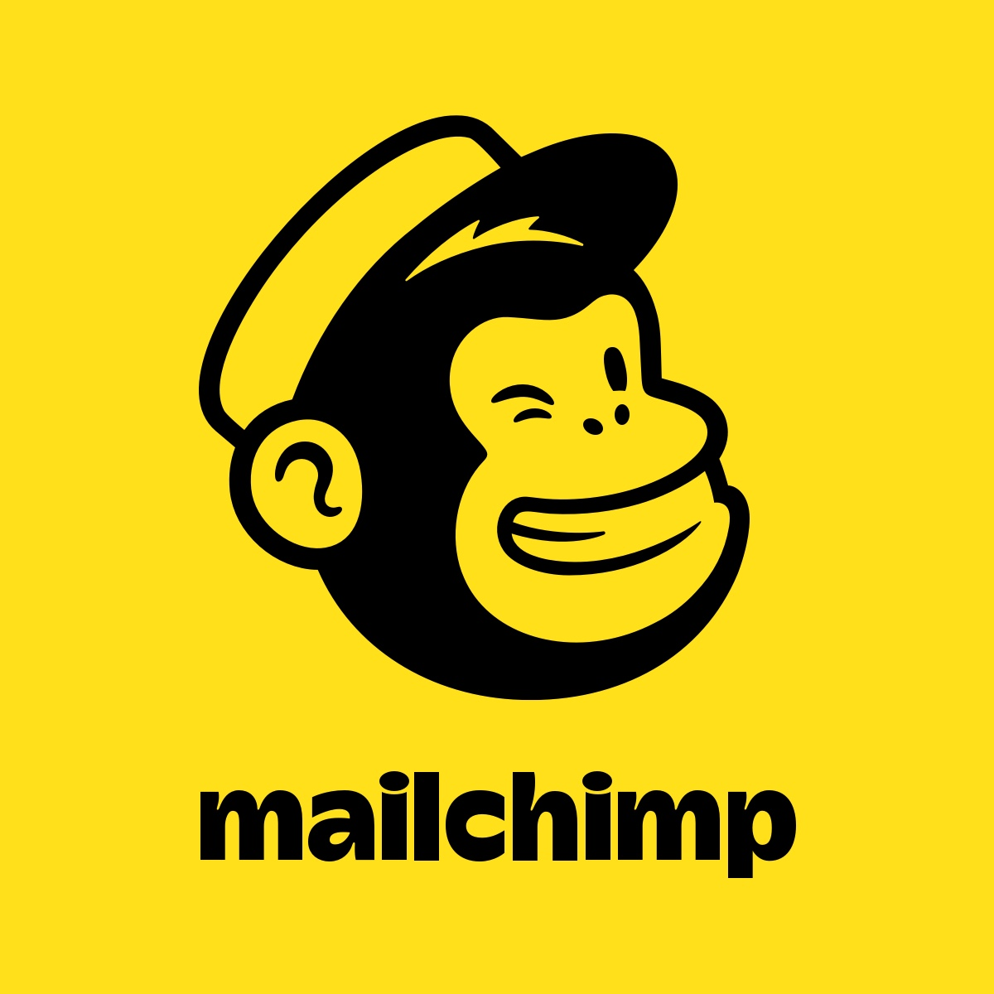
6. Email Marketing
Requirements:
Emails collected from online Booking forms
Primary used for client and visitor informing and
reaching out
Managed by Mailchimp integration
Create custom Eamil campaigns – segment them
Enables A/B testing for campaigns
Mobile ready Emailing campaigns
Track open rate and etc – analyse campaigns and automate them
Let unsubscribe and etc
Notes:
https://mailchimp.com/integrations/wordpress/

Slide 38
Conclusions
Keep it Technologically simple – focus on advantage over competitors
To succeed in SEO, the most crucial factor is consistently producing high-quality, relevant content that addresses your target audience's needs and interests, while following best practices for on-page and technical optimization
The most important element of successful content marketing is consistently producing valuable, relevant, and interesting content that is addressed to target audience
Simple prospect collection for campaigns etc.

Slide 39
Beauty saloon
Research presentation
Guidelines and requirements
Raimonds Arājs, Jurijs Bojārs, Māris Peskops

